Slide 1
Chapter 2
Health Care Settings and the Health Care Team

Slide 2
Ambulatory Health Care Settings
Individual and group medical practices
  Individual practices
    Also called the solo practice
    One primary provider sees and treats patients
    One provider responsible for all costs

Slide 3
Ambulatory Health Care Settings
Individual and group medical practices
  Group practices
    Two or more providers share costs
    Providers consult each other
    Patients may request same provider for all appointments
    Ensures there is always a provider on call
    About 68% of providers practice in a group

Slide 4
Ambulatory Health Care Settings
Urgent care centers
  Usually private, for-profit centers
  Provide primary care, treat routine injuries and illnesses, and perform minor surgery
  Providers are often salaried employees
  See higher volume of patients, usually for a lower cost than hospital emergency room

Slide 5
Ambulatory Health Care Settings
Managed care operations
  Health maintenance organizations (HMOs) provide full range of services under one roof
  Preferred provider organization (PPO) is a physician’s network
  Independent physician association (IPA) treats patients for an agreed-upon fee

Slide 6
Ambulatory Health Care Settings
Boutique or Concierge Medical Practice
  Sought by patients discouraged with insurance reimbursement
  Provides immediate access to provider 24/7
  Convenient, unhurried appointments
  Unlimited email, fax, phone consultations
  Home/work visits as needed
  Coordination of any specialist referrals
  Set fee for services required for the exclusive service

Slide 7
The Health Care Team
Primary care provider
Specialists
Allied health professionals

Slide 8
The Title “Doctor”
Physicians have earned a Doctor of Medicine degree (MD)
Other medical degrees
  Doctor of Osteopathy (DO), Doctor of Dentistry (DDS), Doctor of Optometry (OD)
Nonmedical disciplines
  Doctor of Education (EdD), Doctor of Philosophy (PhD), Doctor of Psychology (PsyD)

Slide 9
Health Care Professionals
Doctors of Medicine (MD)
  Four years of medical school after baccalaureate degree and 3–7 years of residency
  Must have a state license and earn CEUs every year
Doctors of Osteopathy (DO)
  4 years of medical school after a baccalaureate degree and can work in any specialty area with 2–6 years additional training
  Must have a state license and earn CEUs every year

Slide 10
Alternative Health Care Practitioners
Many carry the title “Doctor” and have specialized training
CDC estimates that 36% of patients use alternative medicine

Slide 11
Alternative Health Care Practitioners
Doctors of Chiropractic (DC)
  Pay special attention to physiological and biochemical aspects of body structure
  Adjust and manipulate the spinal column
  Licensed in all 50 states
Doctors of Naturopathy (ND)
  Attempt to remove the underlying cause of disease and stimulate the natural healing process
  Licensed in some states; may practice independently unlicensed, or practice under direction of MD
Notes:
Doctors of Chiropractic: complete 4–5 years of chiropractic college
Doctors of Naturopathy: attend naturopathy colleges for 4 years; are licensed in 13 states, 4 Canadian provinces, Puerto Rico, and the Virgin Islands

Slide 12
Alternative Health Care Practitioners
Oriental Medicine
  Acupuncture, Chinese herbology, bodywork, dietary therapy and exercise
  Attempts to restore the energy flow in body’s meridians
  Nearly all states regulate practice of acupuncture and Oriental Medicine
Notes:
Requires minimum of 2-year undergraduate education and 3 years of specialty training.

Slide 13
The Role of the Medical Assistant
Performs both administrative and clinical functions
  Receptionist, secretary, office manager, bookkeeper, patient educator, insurance coder and biller, etc.
  Screens patients when scheduling appointments
Maintains a positive attitude
Functions under supervision of professionals

Slide 14
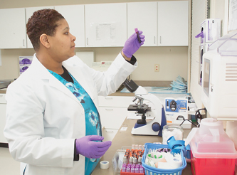
Other Allied Health Professionals
Health unit coordinator (HUC)
Medical laboratory technologist (MLT)
  MLT performing blood analysis >>

Slide 15
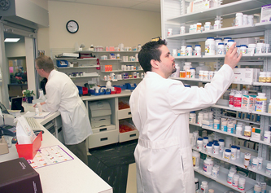
Other Allied Health Professionals
Registered dietitian (RD)
Pharmacist (RPh)
Pharmacy technician
  Pharm tech working with the pharmacist >>

Slide 16
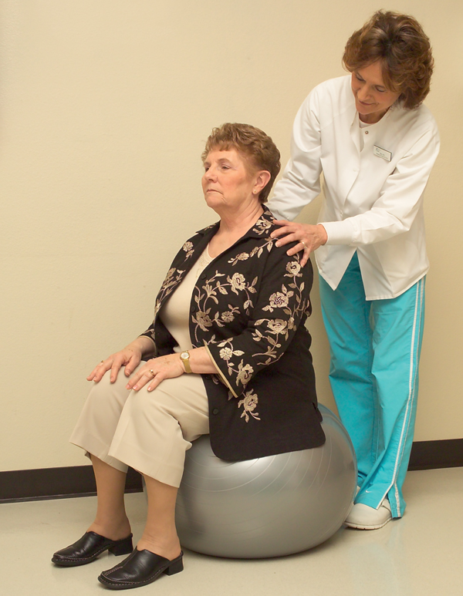
Other Allied Health Professionals
Phlebotomist (LPT)
Physical therapist (PT)
Physical therapy assistant (PTA)
Nurse (RN, LPN, CNA’)
  PT working with a patient >>

Slide 17
Nurse Practitioner
ARNP in state of Florida
Can perform diagnostic, preventive, and therapeutic health care
May prescribe most medications; can supervise technicians and medical assistants
Must complete formal education (RN + Master’s Degree in Nursing)

Slide 18
Physician Assistant
PA or PA-C
Can perform diagnostic, preventive, and therapeutic health care services delegated by the supervision of a physician or surgeon
May prescribe most medications; can supervise technicians and medical assistants
Must complete formal education and pass the Physician Assistant National Certifying Examination

Slide 19
The Value of the Medical Assistant
As communicator and liaison between physician, patient, hospital staff, etc.
First to come in contact with the patient
  Directs, informs, and guides patient

Slide 20

The Value of the Medical Assistant
Click to play the video

